Slide 1
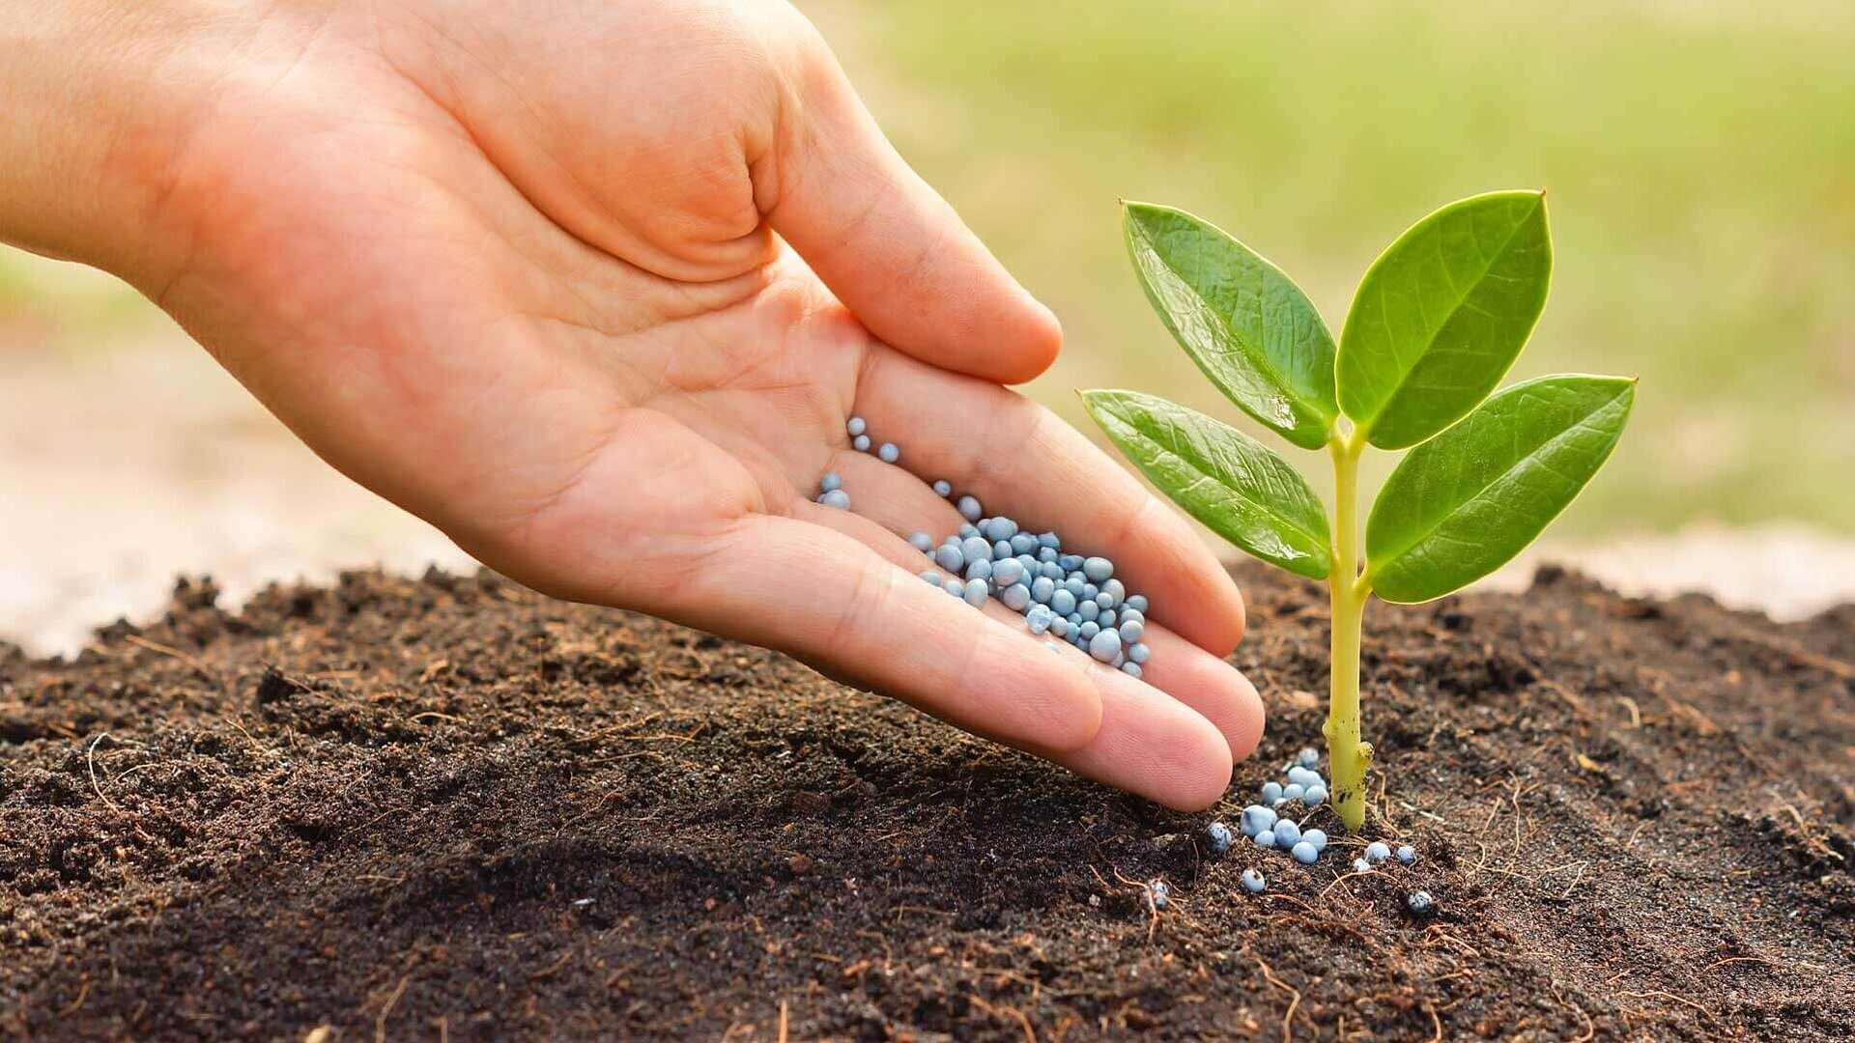
AgriAdvisor
Apoorva Gonegari
Chandana Kolluru
Dheeraj Chetti

Slide 2
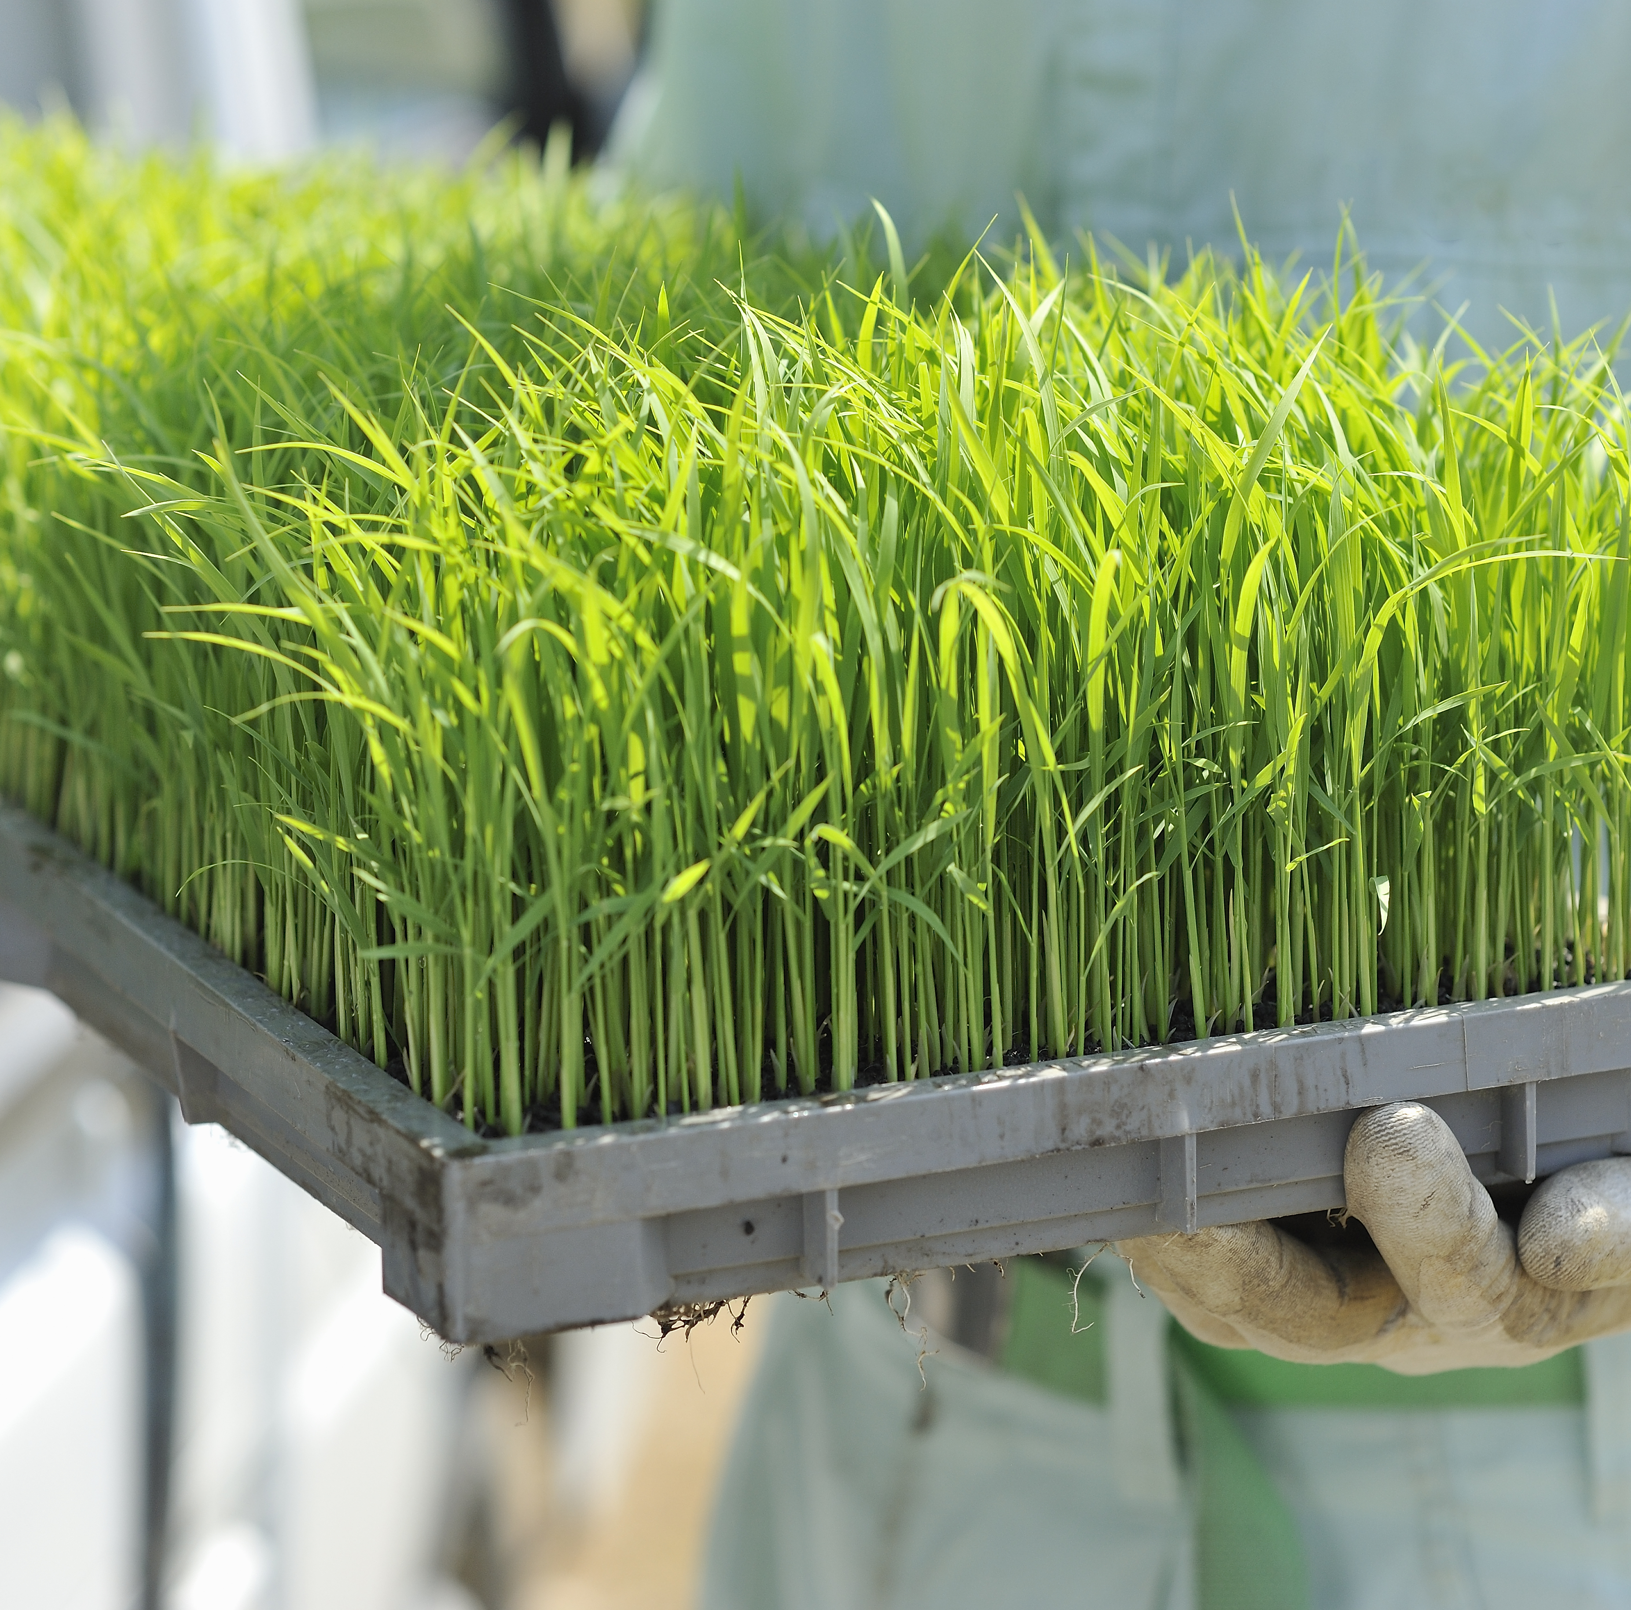
Introducing a Greener Tomorrow: Empowering Agriculture with AI
The global population is projected to reach 9.7 billion by 2050, leading to an unprecedented demand for food production.
In today's fast-paced world, agriculture faces an incredible challenge: how to feed a growing global population while conserving resources and minimizing environmental impact.
Imagine a world where every farmer, regardless of their experience, can make informed decisions that boost crop yields, reduce waste, and ensure healthier plants.
Traditional farming methods can be resource-intensive and often lead to unpredictable outcomes. This is where our project steps in.
Welcome to the future of agriculture, where data science and AI are revolutionizing farming practices.

Slide 3
Problem Statement: AgriAdvisor's Solutions to Agricultural Challenges
Crop Recommendation:
Challenge: Farmers often face difficulties in choosing the most suitable crops for their specific climate, soil conditions, and market demands.
Solution: AgriAdvisor employs advanced algorithms and machine learning to analyze environmental factors, historical data, and market trends. It provides personalized crop recommendations, helping farmers make informed decisions for optimal yield and market value.
Fertilizer Recommendation:
Challenge: Inefficient use of fertilizers can lead to increased costs, environmental pollution, and diminished soil health.
Solution: AgriAdvisor tackles this issue by offering precise fertilizer recommendations based on soil composition, crop type, and growth stage. This targeted approach minimizes waste, improves nutrient uptake, and promotes sustainable farming practices.
Plant Disease Recommendation:
Challenge: Identifying and managing plant diseases is a complex task, and delayed intervention can result in significant crop losses.
Solution: AgriAdvisor integrates image recognition technology and data analytics to identify early signs of plant diseases. By analyzing images of crops, the platform can diagnose potential issues and recommend timely and targeted interventions, reducing the impact of diseases on crop yield.

Slide 4
Harnessing the Power of Data
We've scoured vast datasets from United States Department of Agriculture .
We've also tapped into the rich and diverse New Plant Dataset to gather insights into crop health. Diseases
Weather is a critical factor in agriculture. We obtained historical and real-time weather data from meteorological agencies to analyze its impact on crop performance.
Our approach is holistic. It's not just about identifying diseases and suggesting treatments. It's about recognizing the entire ecosystem of farming, where art and science come together to nurture crops, ensure food security, and sustain livelihoods.

Slide 5
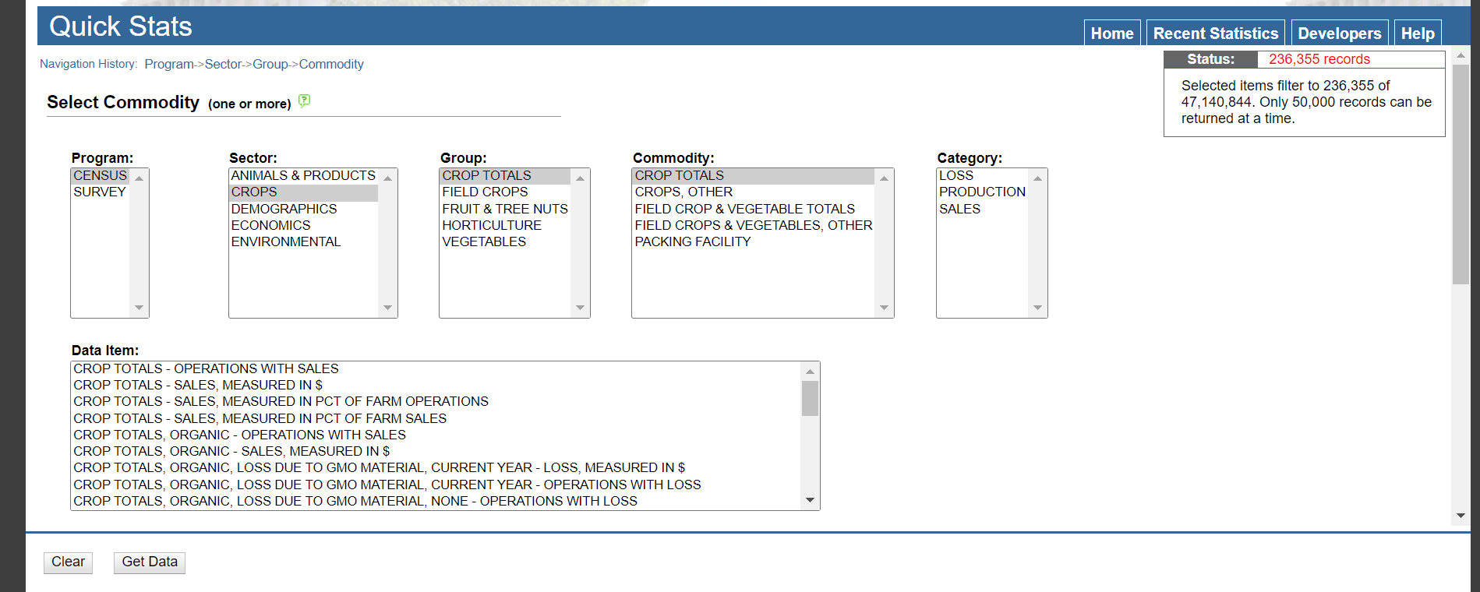
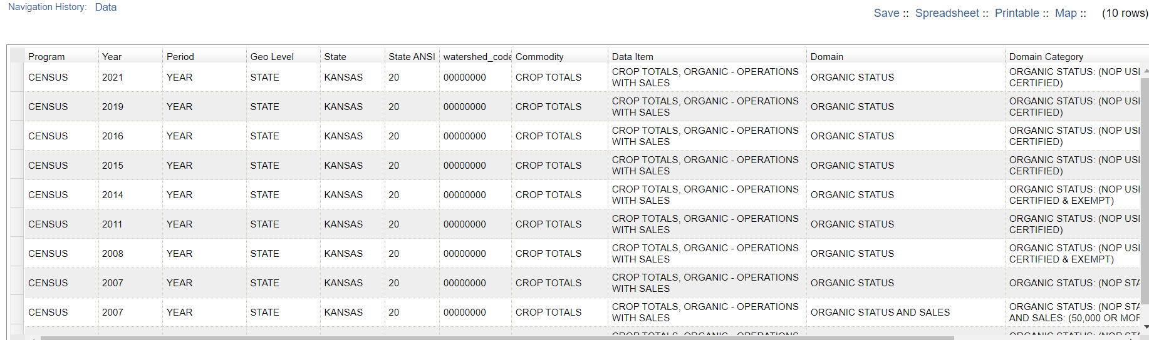
Dataset Overview

Slide 6
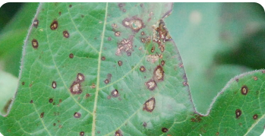
New Plant Diseases Dataset
This dataset is recreated using offline augmentation from the original dataset. The original dataset can be found on this github repo.
This dataset consists of about 87K rgb images of healthy and diseased crop leaves which is categorized into 38 different classes.
The total dataset is divided into 80/20 ratio of training and validation set preserving the directory structure.
A new directory containing 33 test images is created later for prediction purpose

Slide 7
Methodologies
Seamlessly combining agricultural expertise with the precision of data science and AI.
Our approach is a harmonious blend of art and science. On one hand, we harness the power of state-of-the-art technologies like ResNet-9, Support Vector Machines to predict and recommend the crops and fertilizers ,XGBoost to decode plant diseases from images. These cutting-edge techniques allow us to provide accurate and data-driven insights.
Through our advanced algorithms, we extract valuable insights from images of plant leaves. We can identify diseases, assess their severity, and recommend suitable treatments.
These insights are based on rigorous data analysis, ensuring precision and reliability.

Slide 8
Data Preparation and Analysis
Data Collection
Data Cleaning:
Handling Missing Values
Outlier Detection and Removal
Data Formatting
Handling Duplicates
Dealing with Inconsistent Data
Data Integration
Machine Learning Models
Training Data Split
Data is collection from USDA and Kaggle
Python
SVM
XGBoost Resnet
70-training
20-testing
10-validation

Slide 9
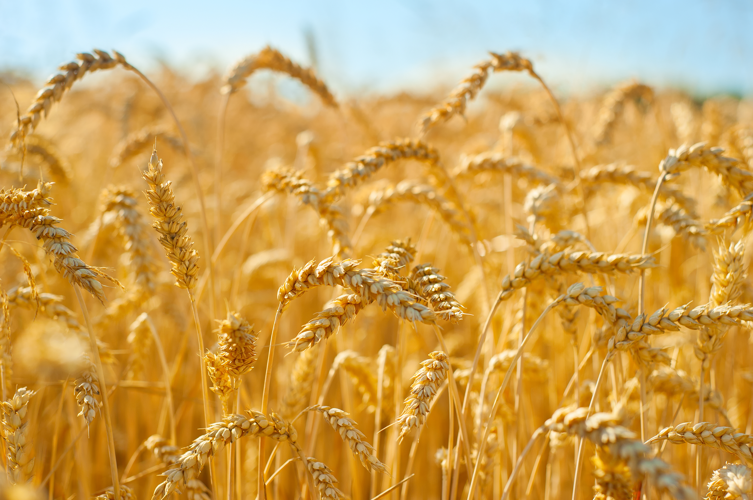
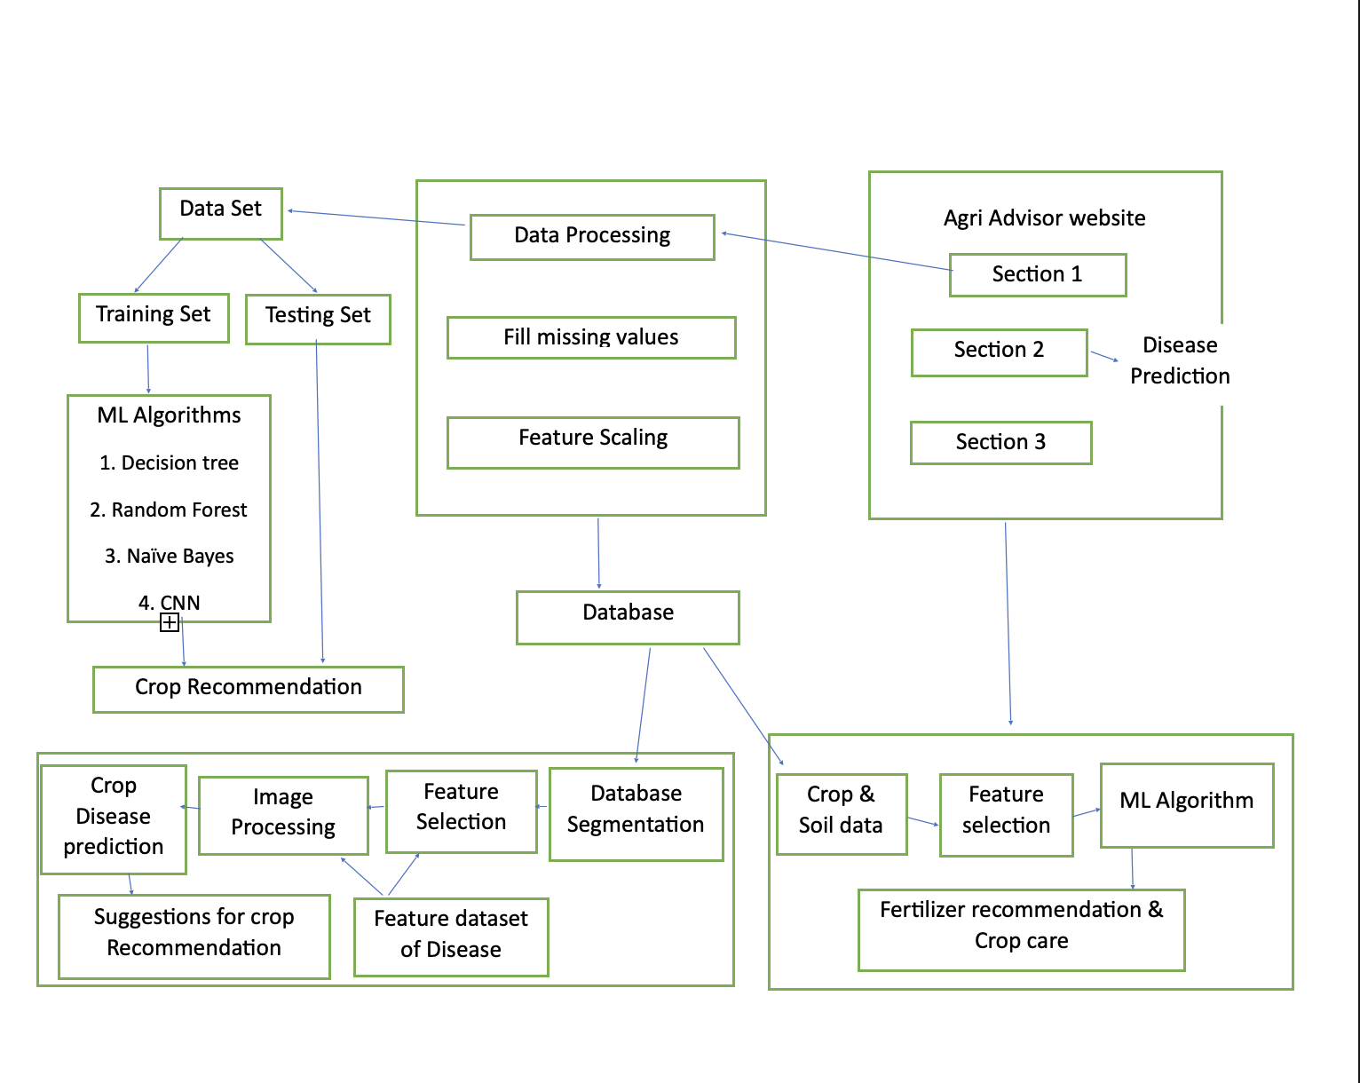
System Diagram

Slide 10
Modeling – Machine Learning Algorithms
Decision Trees for Crop Recommendation and Disease Prediction
Decision Trees are employed to analyze complex relationships in environmental and historical data.
They enable the platform to provide personalized crop recommendations and predict potential diseases based on identified patterns.
Regression Models for Fertilizer Optimization
Regression models are utilized to analyze soil composition, weather conditions, and historical farming data.
Neural Networks for Image Recognition in Disease Identification
Neural Networks, specifically ResNet architecture, are employed for image recognition.
Images of crops are labeled for diseases, allowing the model to identify and diagnose plant health issues
Support Vector Machines (SVM) for Data Classification
SVM is utilized for classification tasks, such as categorizing crops based on specific characteristics.
It aids in refining crop recommendations and tailoring advice to suit the unique needs of different crops.
XGBoost for Enhanced Predictive Analytics
XGBoost is employed to enhance predictive analytics, considering multiple factors like weather, soil, and historical trends.
It contributes to the platform's ability to predict future trends and challenges, enabling proactive decision-making.

Slide 11
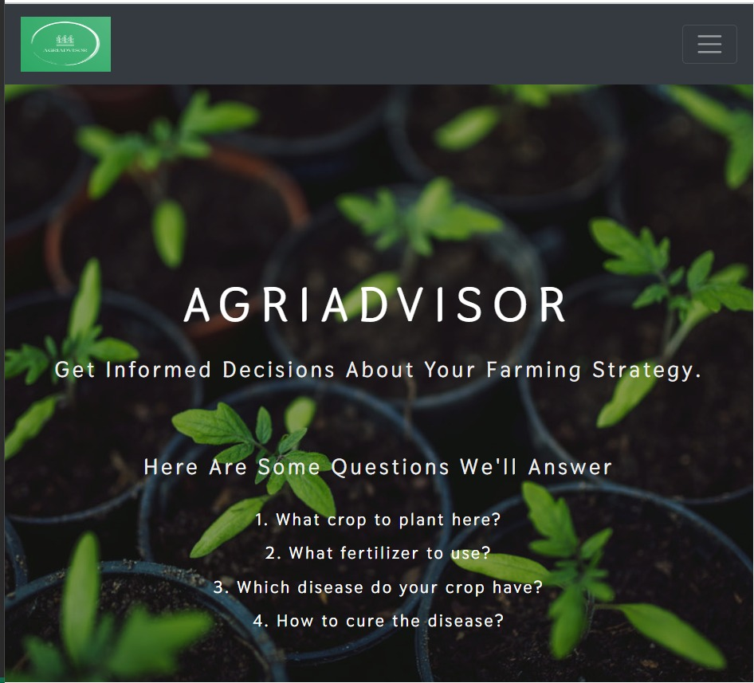
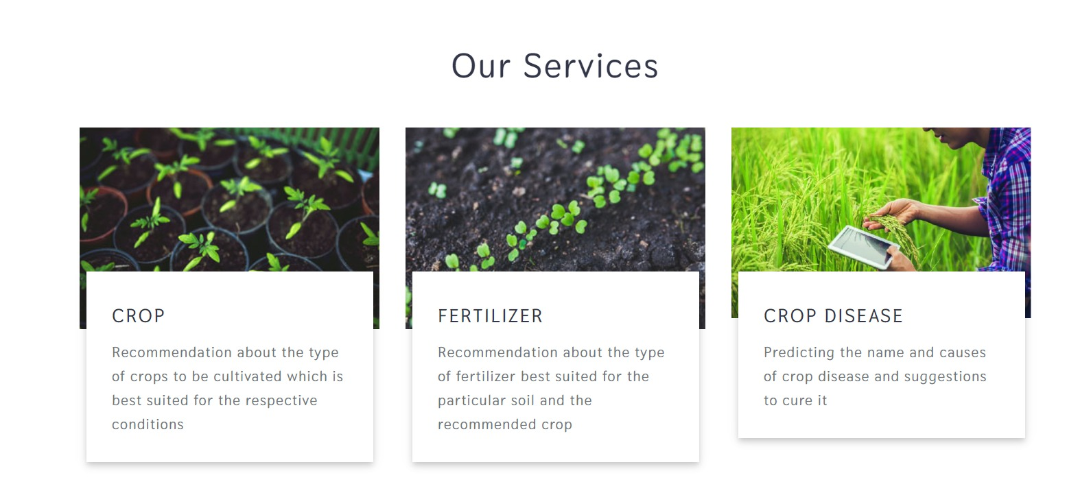
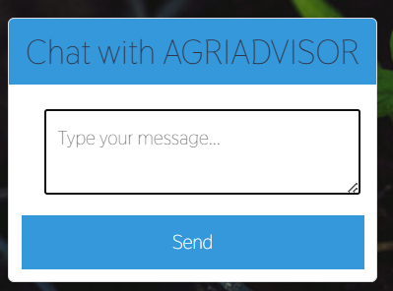
Results - Homepage

Slide 12
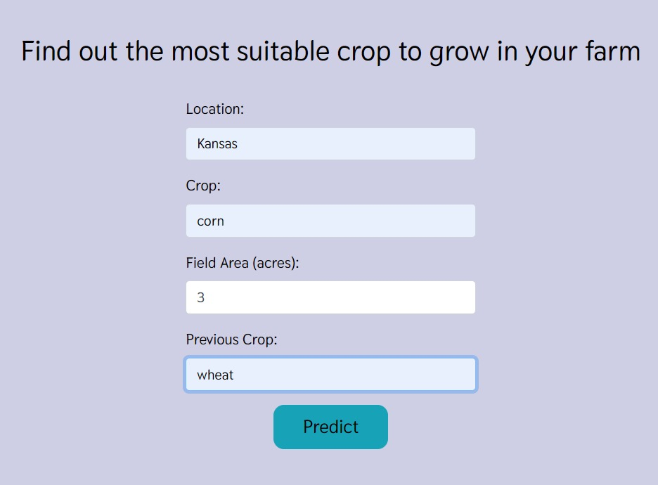
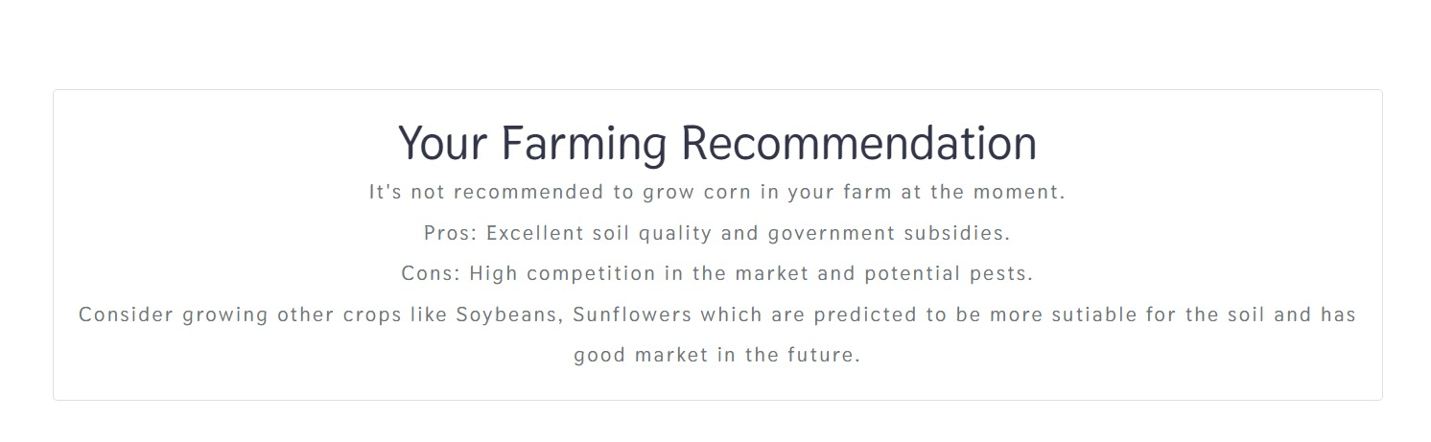
Results - Crop Recommendation

Slide 13
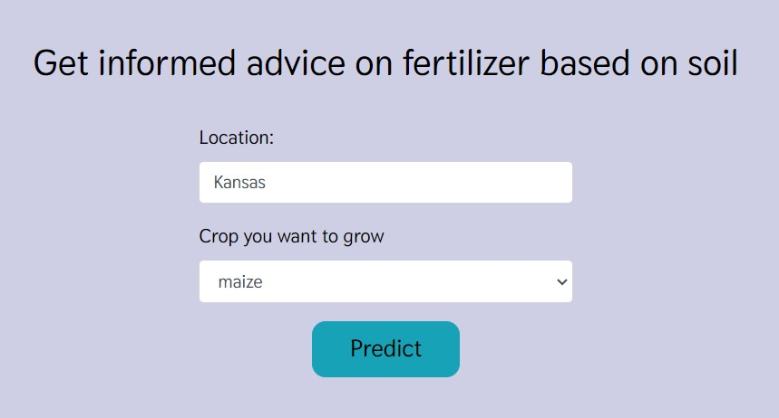
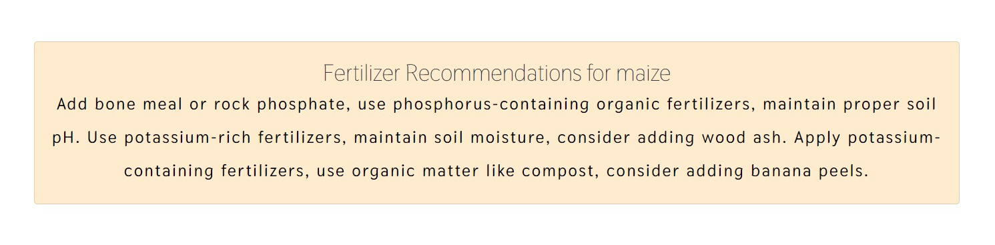
Results – Fertilizer Recommendation

Slide 14
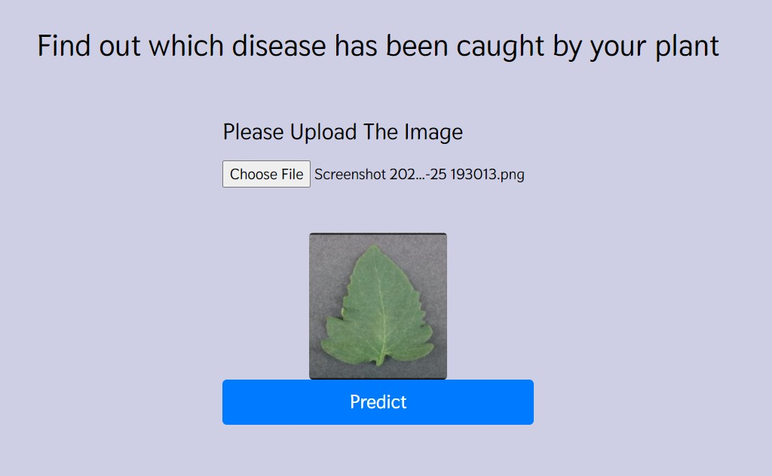
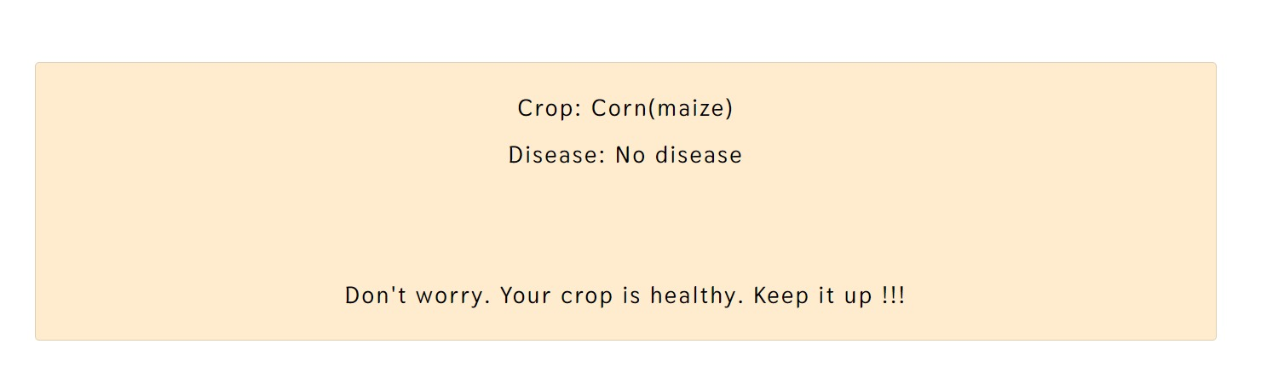
Crop disease prediction and results

Slide 15
What to Expect
Picture this: a farmer inputs their soil data into our system. In seconds, it recommends the best crop for their land. No more guesswork, just science-backed decisions that optimize yield.
Moving on to fertilizer recommendations, our AI considers the crop type and soil conditions. It pinpoints deficiencies or excesses, offering precise suggestions for improvement.
And for the final act, the plant disease prediction application. Farmers upload an image of a diseased plant leaf, and our AI springs into action. It identifies the disease, provides background information, and suggests remedies. It's like having a plant doctor at your fingertips.
Join us on this journey to empower agriculture with AI. Together, we can cultivate a greener, more sustainable future for generations to come. The seeds of change have been sown, and we invite you to be a part of the harvest.

Slide 16
Future Works
Currently, we focus on plant disease prediction and remedies. Our future vision includes proactive disease prediction from plant leaf images.
We plan to expand services to include yield prediction, aiding farmers in making informed decisions about planting and harvesting.
We aim to address waste management, predicting waste quantities and providing sustainable disposal guidance for farming.

Slide 17
Thank you !

